Slide 1
UI Testing with Docker
(Even on Windows!)
Bob Baron

Slide 2
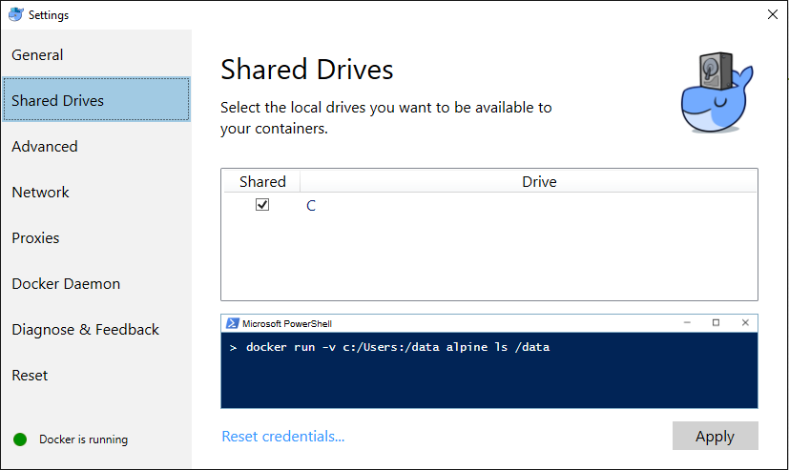
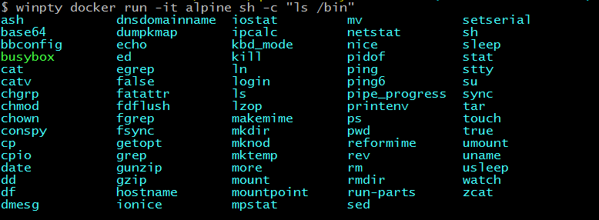
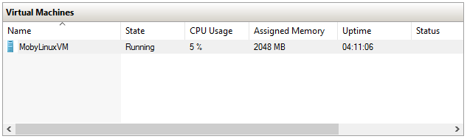
Docker for Windows
Share your drive!
Startup Issues
winpty
Share your drive!
Share your drive!
Startup Issues

Slide 3
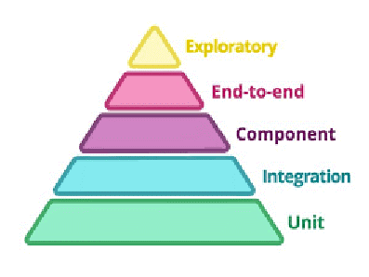
Testing Pyramid
You are here

Slide 4

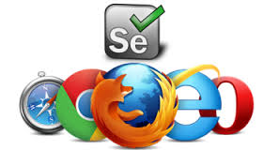
Choose Your Weapon
Protractor (Node.js App)
+
Selenium (Browser automation framework)
=
User interactions in an Angular App
Protractor (Node.js App)
+
Selenium (Browser automation framework)
Protractor (Node.js App)

Slide 5
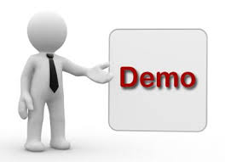

Slide 6
Finding A Home
Troubling Alternatives
Troubling Alternatives
VM Farm
Selenium Grid
Troubling Alternatives
VM Farm
Selenium Grid
The Docker Advantage
“How do I run your tests?”
“It works on my machine!”
Troubling Alternatives
VM Farm
Selenium Grid
The Docker Advantage

Slide 7
The Investigation
PhantomJS
Headless Chrome?
PhantomJS

Slide 8
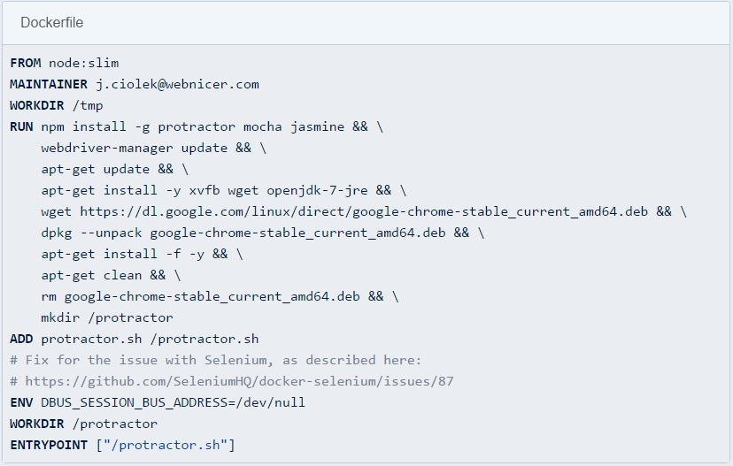
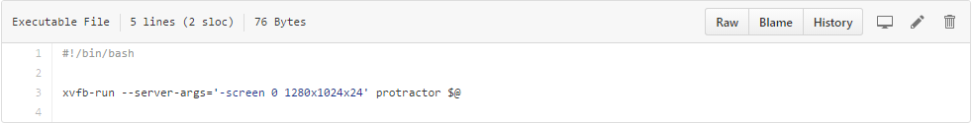
The Solution
webnicer/protractor-headless

Slide 9
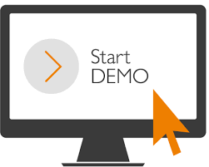

Slide 10
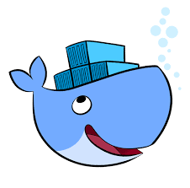

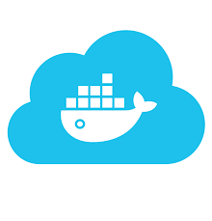


The Implementation
docker-compose (up vs. run)
docker-compose (up vs. run)
Testing As A Service
Github
docker build
docker hub
docker cloud (restart: always)
CircleCI
ELK

